Slide 1

Vel Tech Rangarajan Dr. Sagunthala R&D Institute of Science and Technology
School of Computing
Department of Computer Science and Engineering
10211CS224 / FULL STACK APPLICATION DEVELOPMENT (JAVA)
END SEMESTER PROJECT REVIEW
Date: 06-05-2026
JOB PORTAL MANAGEMENT SYSTEM
SDG No – 9(Industry, Innovation and Infrastructure)
Presented By:
A. Mohamed Ghouse Zuhair - VTU24667 - 23UECS0365
Courses Handling Faculty:
Dr.S.Hemamalini.,M.E.,Ph.D
Assistant Professor(Senior Grade)

Slide 2
INTRODUCTION
The Job Portal Management System is a web-based application for managing recruitment processes.
It provides a centralized platform for job seekers and employers.
Students can search jobs, apply online, and track application status.
Employers can post jobs, manage listings, and view applicants.
The system reduces manual effort and time in the hiring process.
Developed using technologies like Spring Boot, Thymeleaf, and MySQL.
Ensures secure authentication and role-based access (Student, Employer, Admin).
Improves communication between candidates and recruiters.
Provides a user-friendly and efficient interface.
Aims to make the recruitment process simple, fast, and reliable.
1
2
3
4
5
6
7
8
9

Slide 3
PROBLEM STATEMENT
Traditional job searching and recruitment processes are time-consuming and inefficient.
Lack of a centralized platform for managing job postings and applications.
Job seekers face difficulty in finding relevant job opportunities.
Employers struggle to manage large numbers of applications manually.
Limited tracking system for application status (Applied, Shortlisted, Rejected).
Communication between recruiters and candidates is often delayed or unclear.
Existing systems may lack proper filtering and search features.
Manual processes increase the chances of data loss and errors.
No proper system to analyze recruitment data and performance.
1
2
3
4
5
6
7
8
9

Slide 4
OBJECTIVE(S)
To develop a web-based platform for efficient job management and recruitment.
To provide a centralized system for job seekers and employers.
To enable students to search, apply, and track job applications
To allow employers to post, update, and manage job listings easily.
To implement secure authentication and role-based access control.
To simplify the application tracking process (Applied, Shortlisted, Rejected).
To improve communication between job seekers and recruiters.
To ensure efficient data storage and management using MySQL.
To provide a user-friendly interface for all types of users.
To make the recruitment process faster, transparent, and reliable.
1
2
3
4
5
6
7
8
9

Slide 5
PROPOSED SYSTEM
The system proposes a web-based Job Portal Management System to automate recruitment.
Provides a centralized platform for Students, Employers, and Admin.
Students can register, search jobs, apply online, and track application status.
Employers can post jobs, manage listings, and view applicants efficiently.
Admin can monitor users, jobs, and applications across the system.
Implements secure login and role-based access control using Spring Security.
Uses Spring Boot (backend) and Thymeleaf (frontend) for smooth operation.
Stores data securely in MySQL database using JPA/Hibernate.
Provides dynamic dashboards for better user experience.
Reduces manual work and improves speed, accuracy, and transparency in recruitment.
1
2
3
4
5
6
7
8
9

Slide 6
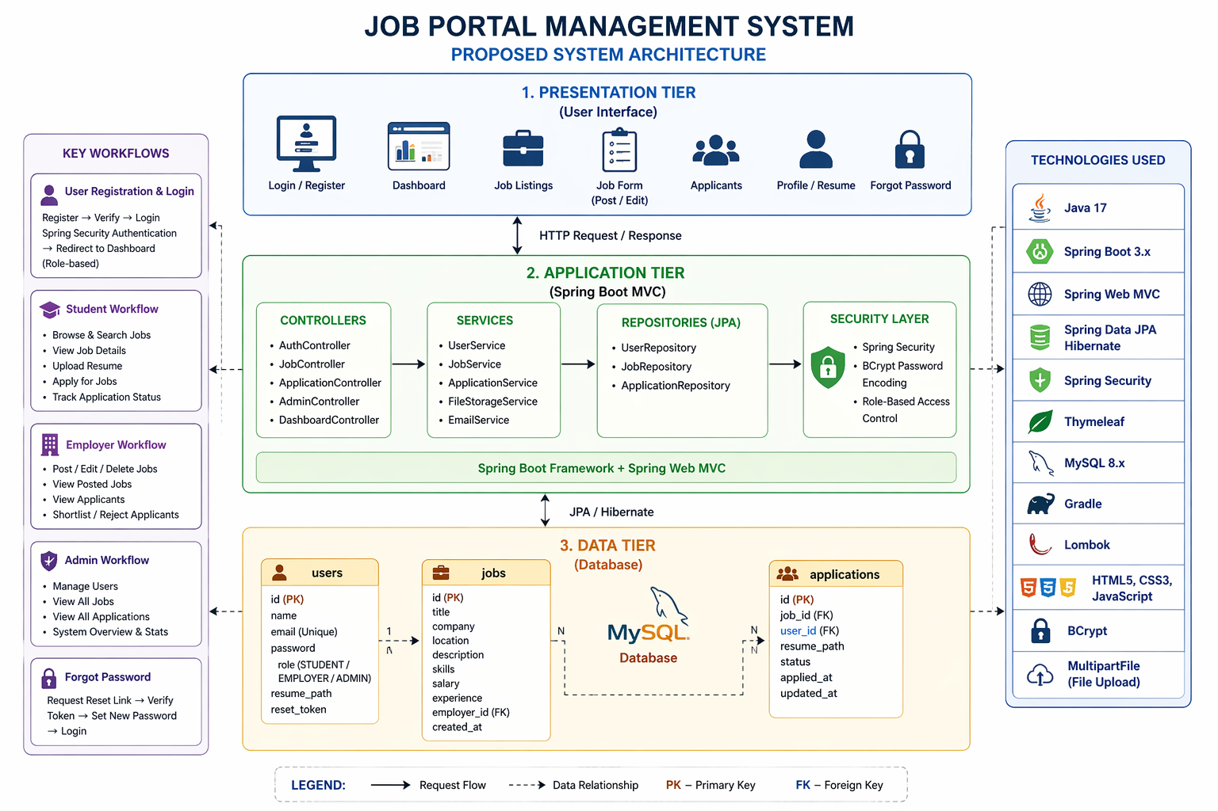
PROPOSED SYSTEM ARCHITECTURE
Input:
Users (Students, Employers, Admin) interact with the system through web interfaces.
Students provide data like profile details, resumes, and job applications.
Employers input job details such as title, description, skills, salary, and location.
All inputs are sent to the backend through HTTP requests (forms / APIs).
Database:
Data is stored in MySQL database.
Main tables include:
users (student, employer, admin details)
jobs (job postings)
applications (job applications and status)
Managed using Spring Data JPA (Hibernate ORM).
Ensures secure storage, relationships, and data consistency.
1
2
3
4
5
6
7
Output:
Dynamic web pages are generated using Thymeleaf templates.
Users get real-time feedback such as:
Job listings and search results
Application status (Applied, Shortlisted, Rejected)
Dashboards based on roles (Student / Employer / Admin)
Notifications and updates are reflected instantly on the UI.
8
9

Slide 7
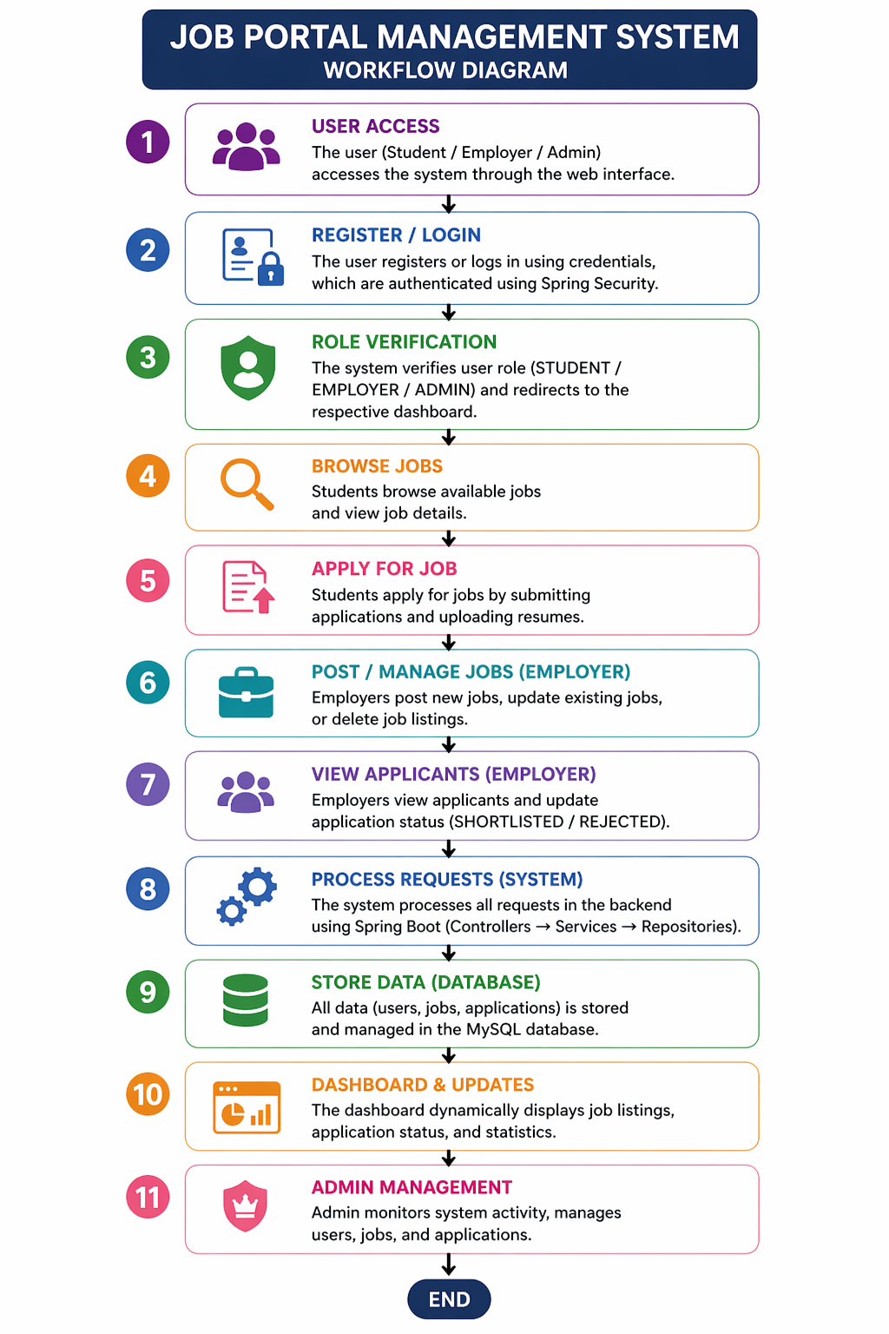
WORKFLOW
The user (Student / Employer / Admin) accesses the system through the web interface (browser).
The user registers or logs in using credentials, which are authenticated using Spring Security.
The system verifies user role (STUDENT / EMPLOYER / ADMIN) and redirects to the respective dashboard.
Students browse available jobs and view job details.
Students apply for jobs by submitting applications and uploading resumes.
Employers post new jobs, update existing jobs, or delete job listings.
Employers view applicants and update application status (SHORTLISTED / REJECTED).
The system processes all requests in the backend using Spring Boot (Controllers → Services → Repositories).
All data (users, jobs, applications) is stored and managed in the MySQL database.
The dashboard dynamically displays job listings, application status, and statistics.
Admin monitors system activity, manages users, jobs, and applications.
1
2
3
4
5
6
7
8
9

Slide 8
TECHNOLOGIES USED
Frontend:
HTML5 – Structures web pages like login, dashboard, job listings, and forms.
CSS3 – Provides styling and responsive design for better user experience.
JavaScript – Handles dynamic interactions like job search, filtering, and validations.
Thymeleaf – Renders dynamic server-side content in web pages.
Backend:
Java – Core programming language used for application development.
Spring Boot – Handles REST APIs, business logic, and application flow.
Spring MVC – Manages request handling (Controllers → Services → Repositories).
Spring Security – Provides authentication and role-based authorization.
WebSocket (Optional) – Enables real-time updates (if implemented for notifications).
Database:
MySQL – Stores all system data such as users, jobs, and applications securely.
1
2
3
4
5
6
7
8
9

Slide 9
MODULE DESCRIPTION
1
Module 1: User Management
Module 2: Job Management
Handles user registration and login (Student / Employer / Admin).
Manages authentication and role-based access using Spring Security.
Allows employers to post, update, and delete job listings.
Stores job details like title, description, skills, salary, and location.
Module 5: Dashboard Visualization
Displays job listings, application status, and statistics.
Provides role-based dashboards for Student, Employer, and Admin.
2
3
4
5
6
Module 3: Database Management
Module 4: Application Management
7
Stores all data (users, jobs, applications) in MySQL database.
Supports efficient data retrieval for dashboards and operations.
8
Enables students to apply for jobs and upload resumes.
Tracks application status (APPLIED, SHORTLISTED, REJECTED).
9

Slide 10
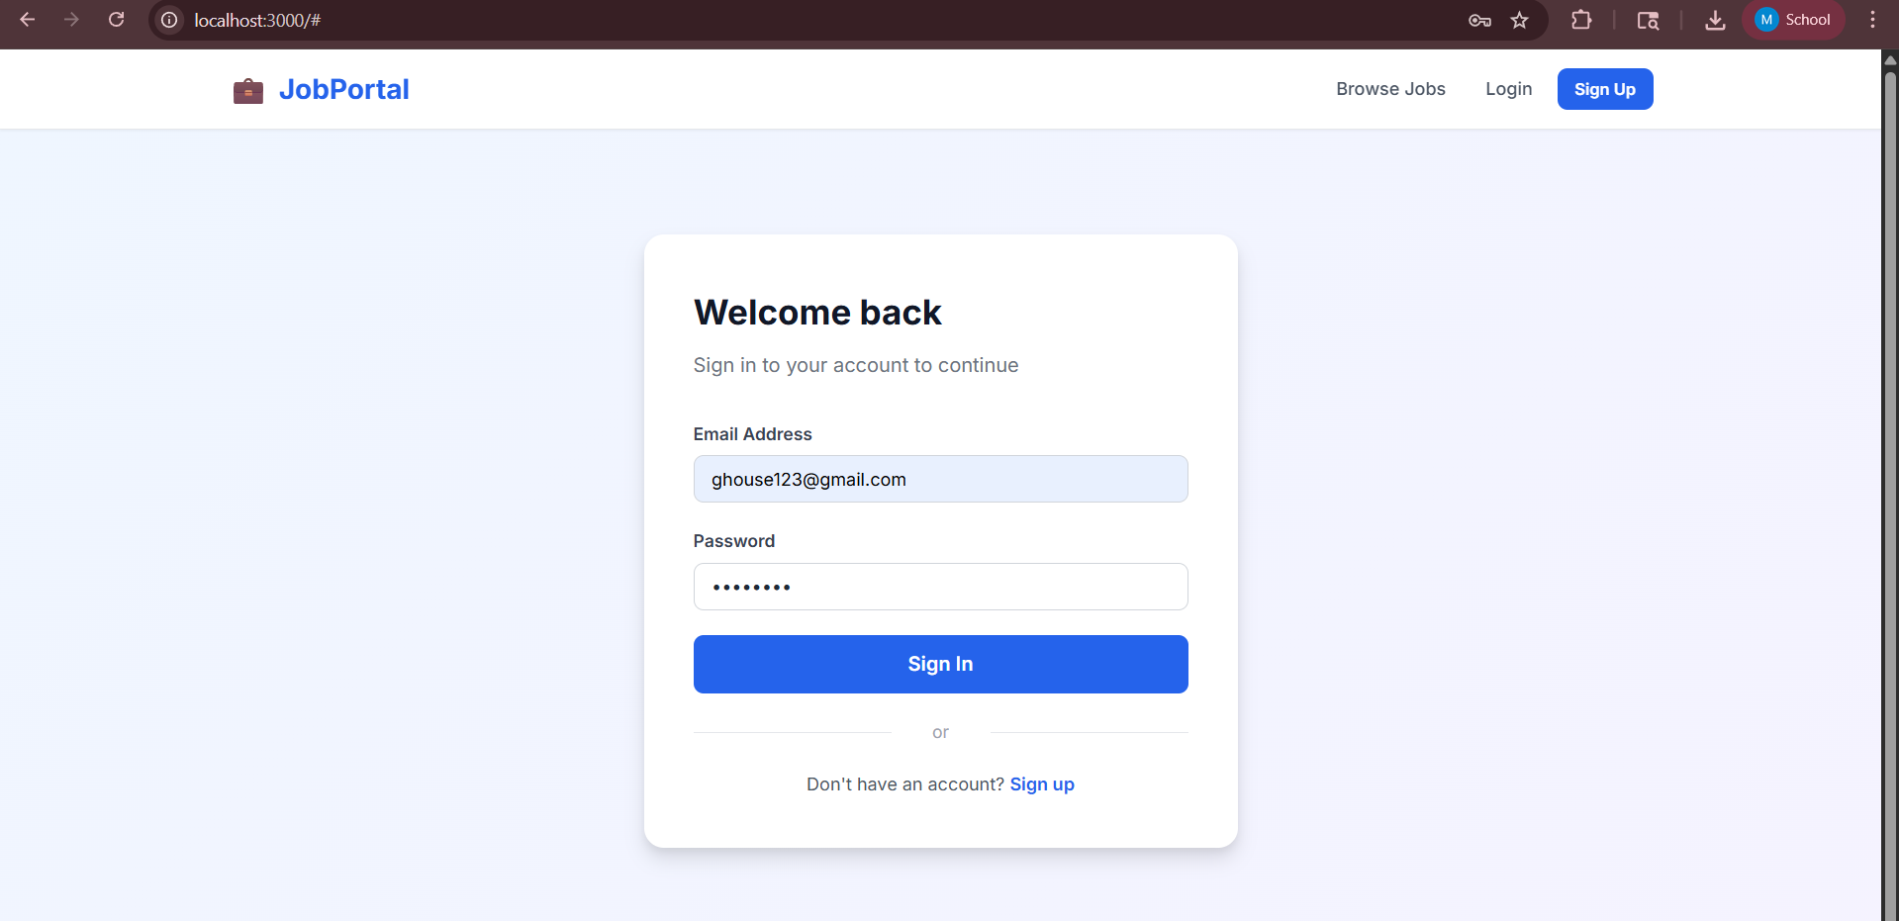
IMPLEMENTATION SCREENSHOTS
1
2
3
4
5
6
7
8
9
Home Page – Dashboard
The home page acts as the main interface of the Job Portal system.
Displays all important information in a centralized dashboard.
Shows job listings, application status, and user-specific data.
Provides role-based views for Students, Employers, and Admin. .

Slide 11
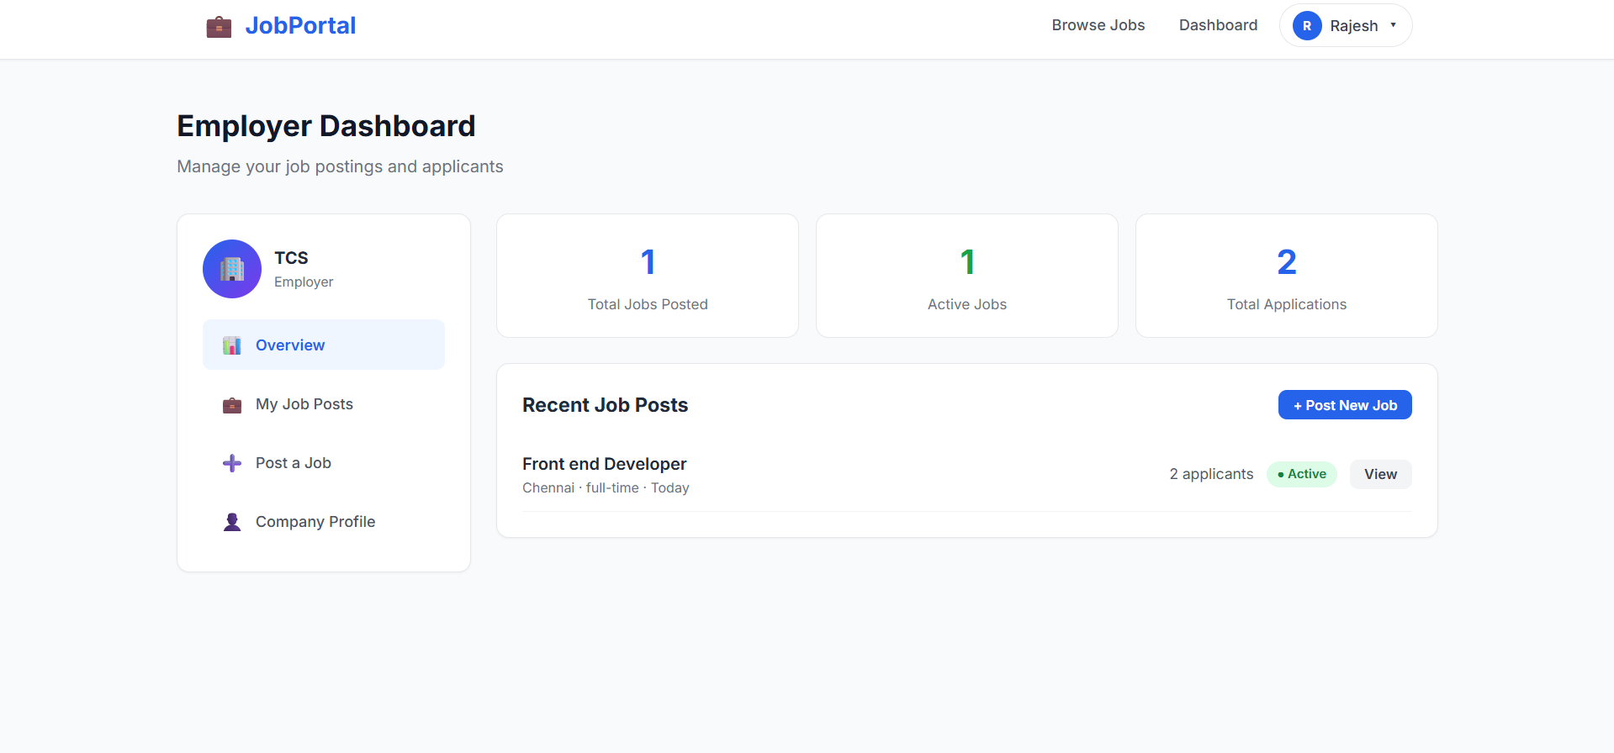
IMPLEMENTATION SCREENSHOTS
1
2
3
4
5
6
7
8(A)
Dashboard / System Monitoring
Displays multiple sections such as job listings, applications, and user activities.
Shows real-time updates of job postings and application status.
Updates dynamically based on user actions (no need for manual refresh).
Provides different views for Students, Employers, and Admin.
Helps users efficiently track jobs, applications, and overall system activity.
9

Slide 12
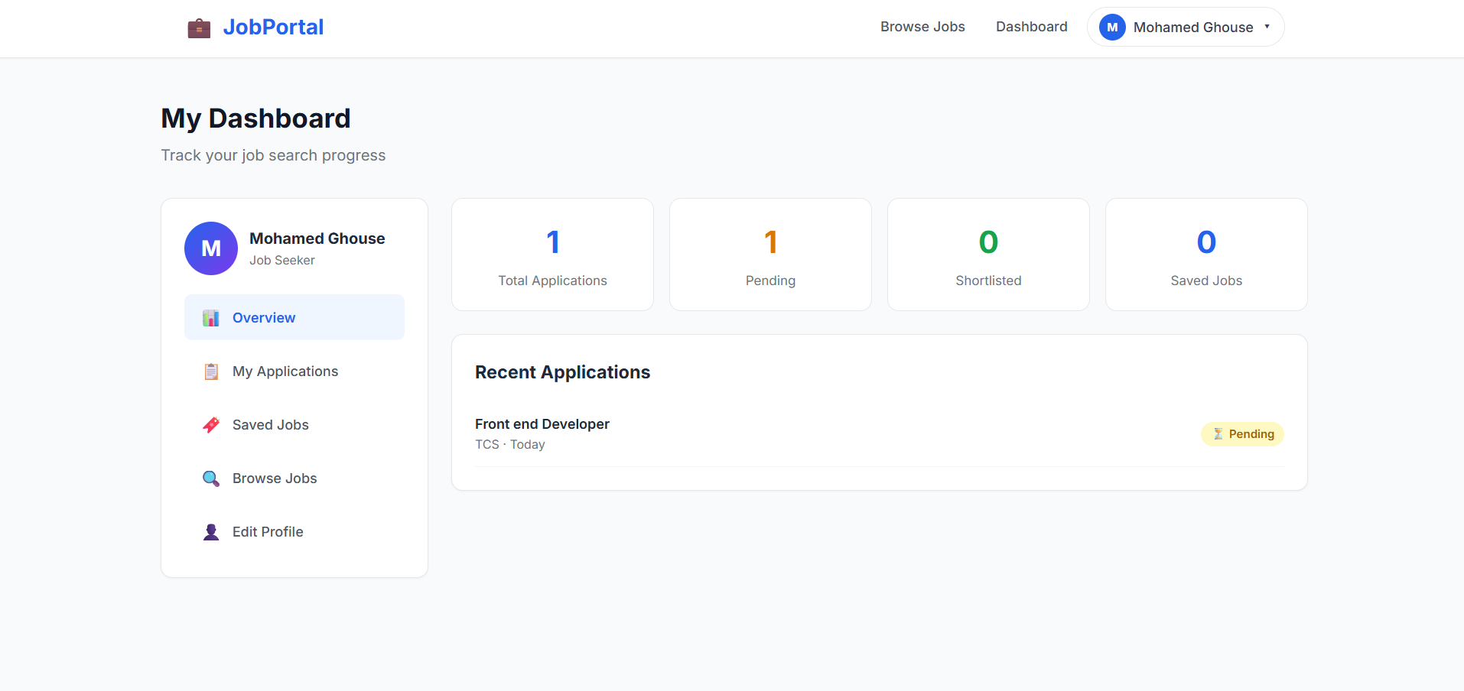
IMPLEMENTATION SCREENSHOTS
Admin Login Page
User Login Page
1
2
3
4
5
6
7
8(B)
9

Slide 13
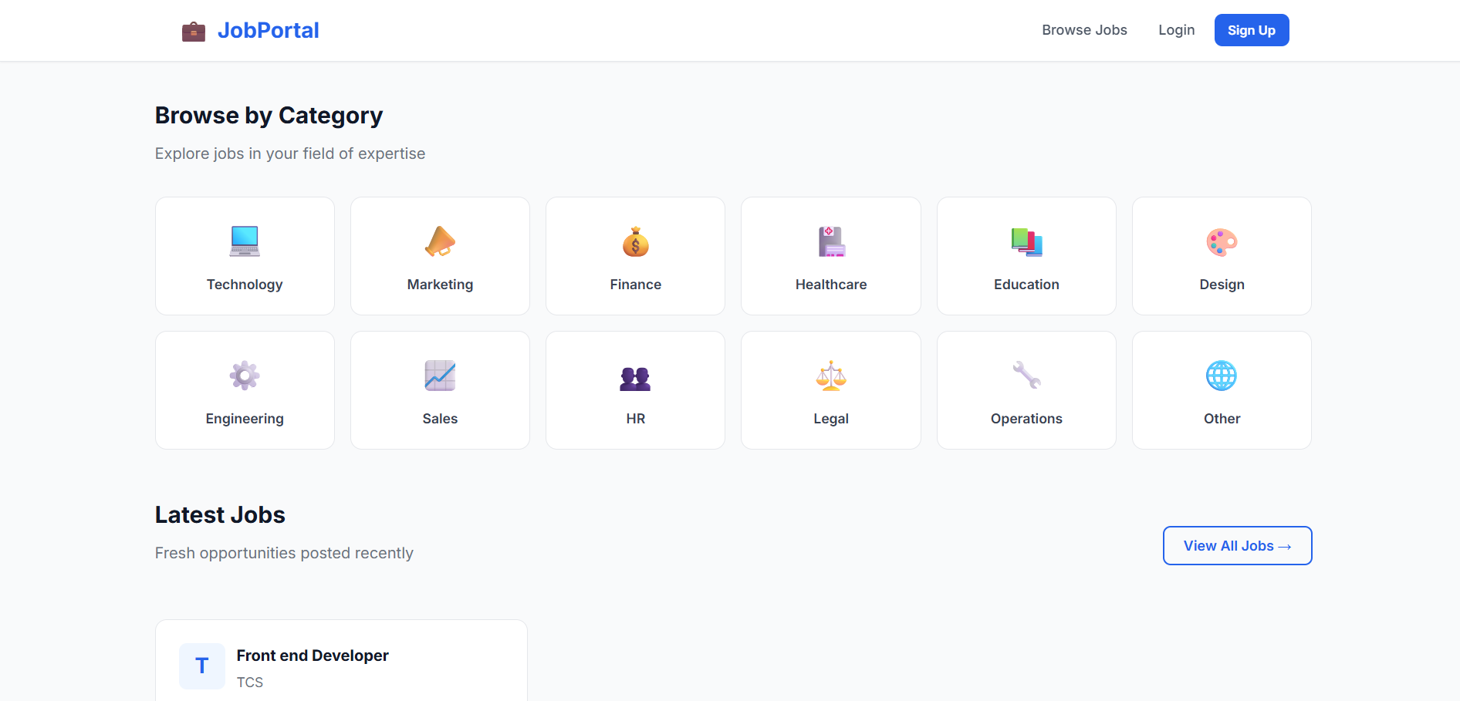
IMPLEMENTATION SCREENSHOTS
1
2
3
4
5
6
7
8(C)
9
Users receive notifications for important updates (e.g., shortlisted or rejected).
Helps students track progress and employers manage applicants efficiently.

Slide 14
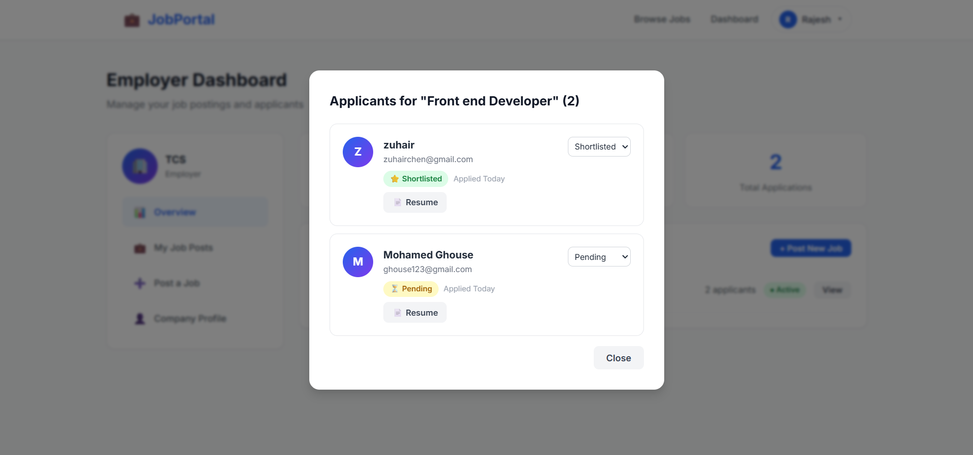
IMPLEMENTATION SCREENSHOTS
1
2
3
4
5
6
7
8(C)
9
Application Monitoring & Notifications
Displays recent job applications with their current status.
Status is clearly indicated (APPLIED, SHORTLISTED, REJECTED). .

Slide 15
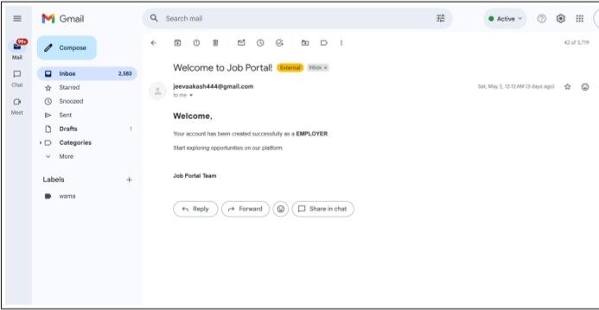
IMPLEMENTATION SCREENSHOTS
1
2
3
4
5
6
7
8(C)
9
Users enter their registered email/username and password to access the system.
The system verifies credentials with database records.
If credentials are correct, user is granted access to the dashboard.

Slide 16
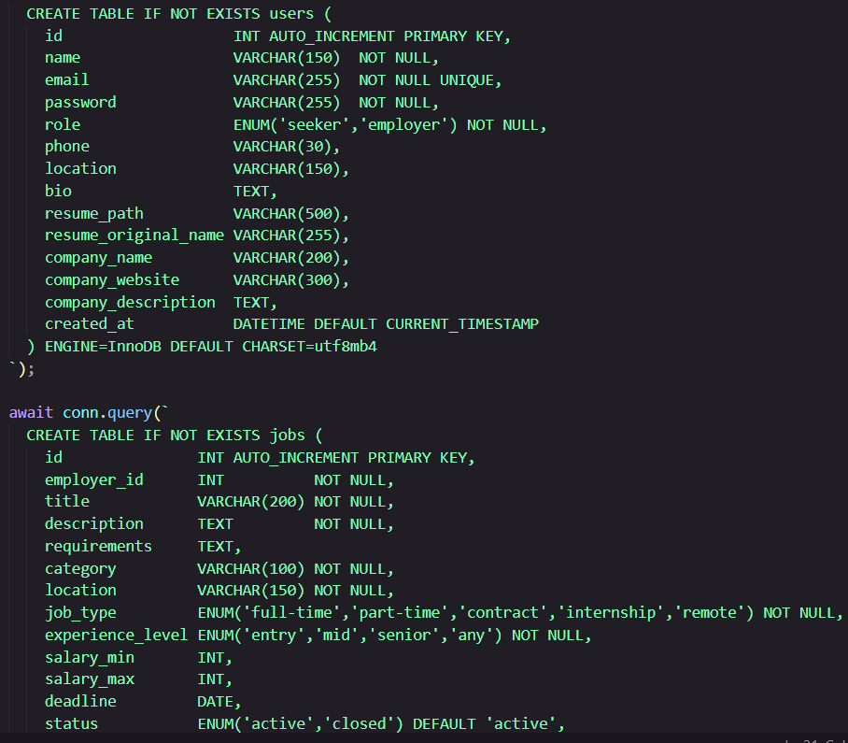
IMPLEMENTATION SCREENSHOTS
1
2
3
4
5
6
7
8(C)
9

Slide 17
ADVANTAGES & LIMITATIONS
Advantages
Provides a centralized platform for job searching and recruitment.
Enables easy job posting and management for employers.
Allows students to apply for jobs and track application status efficiently.
Implements secure authentication and role-based access control.
Offers dynamic dashboards for Students, Employers, and Admin.
Improves communication between job seekers and recruiters.
Ensures efficient data management using MySQL and JPA.
Saves time and enhances the overall recruitment process.
1
2
Limitations
Basic version has limited advanced security features (can be enhanced further).
System performance depends on internet connectivity.
Limited advanced search and filtering options for jobs.
No real-time notifications (if WebSocket/email not implemented).
Limited analytics and reporting features for users and admin.
Scalability may be restricted for very large user traffic without optimization.
3
4
5
6
7
8
9

Slide 18
Thank you

